Slide 1



Module No 6
Programming with Copilot

Slide 2

Disclaimer
The content is curated from online/offline resources and used for educational purpose only

Slide 3

Learning Objective
You will learn in this Chapter:
Understand what GitHub Copilot is
Set up Python + VS Code environment
Install and activate Copilot
Write Python programs using AI assistance
Follow a beginner-friendly Copilot workflow
Notes:
In this chapter, students will first understand what GitHub Copilot is and how it works as an AI-powered coding assistant that helps developers write code more efficiently.
Next, they will learn how to set up the required environment, which includes installing Python and Visual Studio Code so they can start writing and running programs.
Students will then install and activate the GitHub Copilot extension from the VS Code Extensions Marketplace.
After the setup is complete, they will practice writing Python programs with AI assistance, where Copilot suggests code snippets, functions, and possible solutions while they type.
Finally, students will follow a simple beginner-friendly workflow that involves thinking about the problem, writing comments, reviewing Copilot suggestions, testing the code, and improving the solution.

Slide 4

Who Should Take This Module?
ITI / Polytechnic / Beginner students
No prior coding experience required
Only curiosity & willingness to explore
Anyone interested in AI-powered programming
Notes:
This module is designed especially for ITI and Polytechnic students, as well as beginners who are interested in learning programming in a simple and practical way. It is suitable for students who are just starting their journey in technology and want to explore modern tools like AI-assisted coding.
The good news is that no prior coding experience is required to take this module. Even if you have never written a program before, you will still be able to follow along and learn step by step.
What we really expect from participants is curiosity and a willingness to explore. Technology, especially Artificial Intelligence, is evolving rapidly, and this module encourages learners to experiment, ask questions, and try new ideas while coding.
Finally, this module is perfect for anyone interested in AI-powered programming.

Slide 5
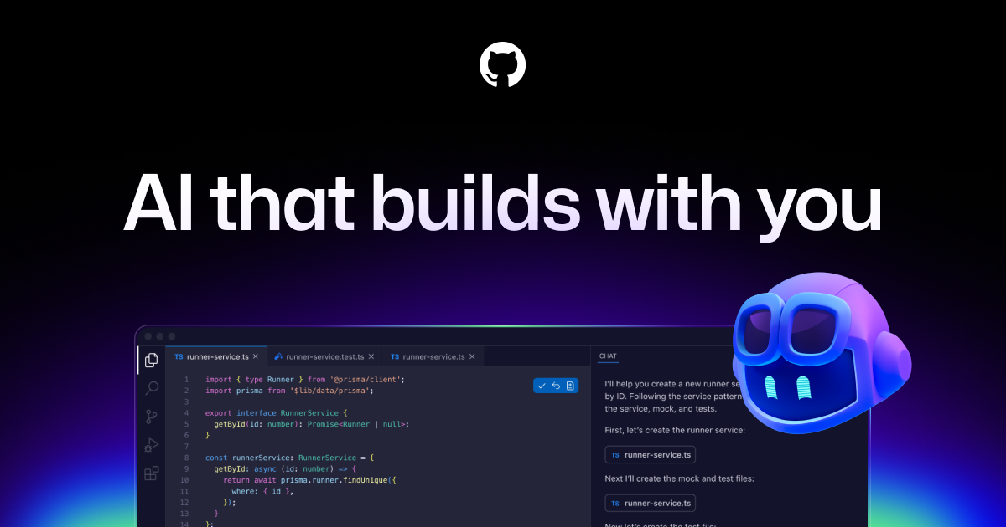
What is GitHub Copilot?
GitHub Copilot is AI Coding Friend
https://youtu.be/81bO8qnkR9M
GitHub Copilot is an AI-powered coding assistant that helps programmers write code faster by suggesting code snippets, functions, and entire programs while you type.
It works inside code editors like Visual Studio Code and supports multiple programming languages, like Python.
When a comment or a line of code is typed, Copilot predicts what the user want to write next and shows a suggestion.
Notes:
Think of GitHub Copilot as: Your AI Coding Friend
Just like a friend sitting next to you while coding:
You say what you want to build
Your friend suggests how to write the code
You review it and decide whether to use it
Copilot does the same thing automatically while you type.

Slide 6
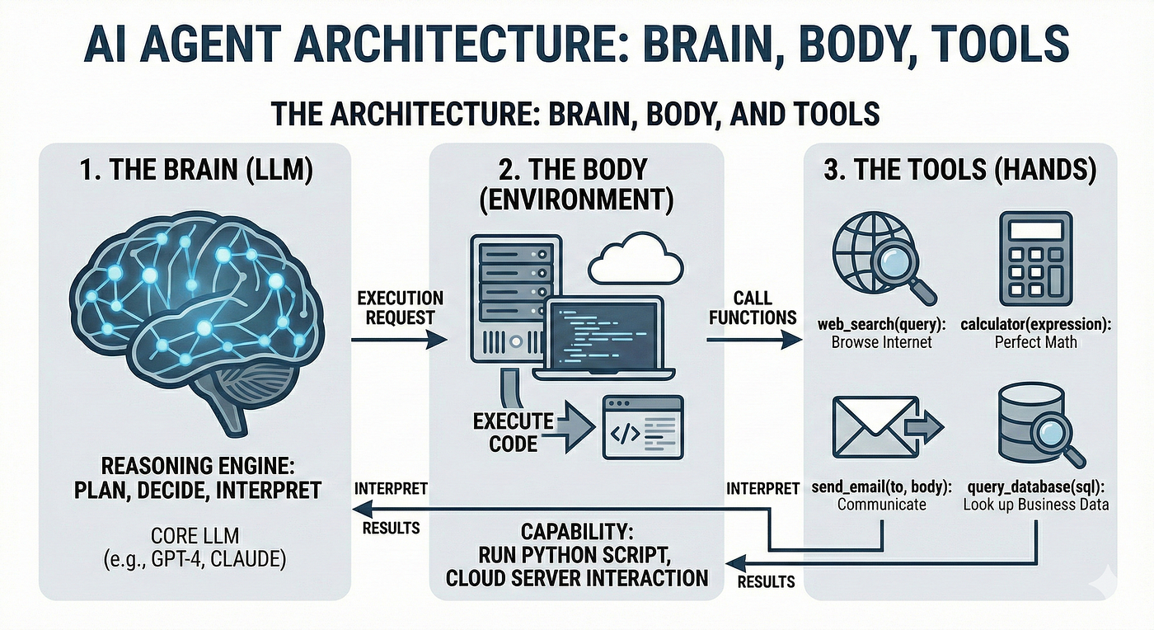
How It Works:
You write a comment or start typing code
Copilot analyzes context
It predicts the next lines
Shows suggestion in gray (ghost text)
Like auto-complete — but smarter and context-aware.
Notes:
Let’s understand how GitHub Copilot actually works while coding.
The process usually starts when you write a comment or begin typing some code. For example, you might type a comment like “Python program to print student details.”
Copilot then analyzes the context of what you are writing. It looks at the comment, the existing code in the file, and even the programming language you are using.
Based on this context, Copilot predicts the next possible lines of code that you might want to write. This prediction is generated using AI models trained on large amounts of programming data.
The suggested code appears in gray color inside the editor, which is called ghost text. This text is only a suggestion and does not become part of your code until you accept it.
If the suggestion is correct, you can press the Tab key to accept it instantly, saving time and effort.
So, you can think of Copilot as auto-complete in programming—but much smarter and context-aware, because it understands what you are trying to build and suggests meaningful code instead of just single words.
This makes coding faster, easier, and more efficient, especially for repetitive tasks or when learning new programming concepts.

Slide 7
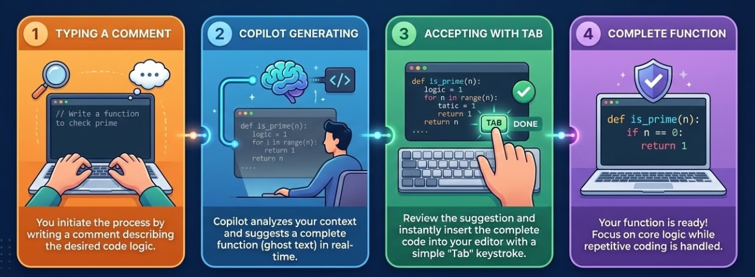
Copilot in Real Life
Notes:
Today, AI copilots are becoming assistants that help professionals work faster, smarter, and more efficiently.
For example, in Excel, Copilot can automatically analyze large datasets, identify trends, and even generate charts or summaries with a simple prompt. This helps users save a lot of time compared to manual analysis.
In Word, Copilot helps draft documents, summarize reports, and improve writing. Instead of starting from scratch, users can ask Copilot to generate a first draft and then refine it.
In PowerPoint, Copilot can convert text into professional-looking presentations, suggest slide layouts, and even generate speaker notes.
Developers use Copilot in coding environments like VS Code to automatically suggest code, complete functions, and help debug errors.
In emails and communication tools, Copilot can draft responses, summarize long email threads, and highlight key points.
Overall, Copilot acts like a smart digital assistant that reduces repetitive work and allows people to focus more on thinking, creativity, and decision-making.
The key idea is that Copilot does not replace humans—it enhances human productivity by working alongside us.

Slide 8
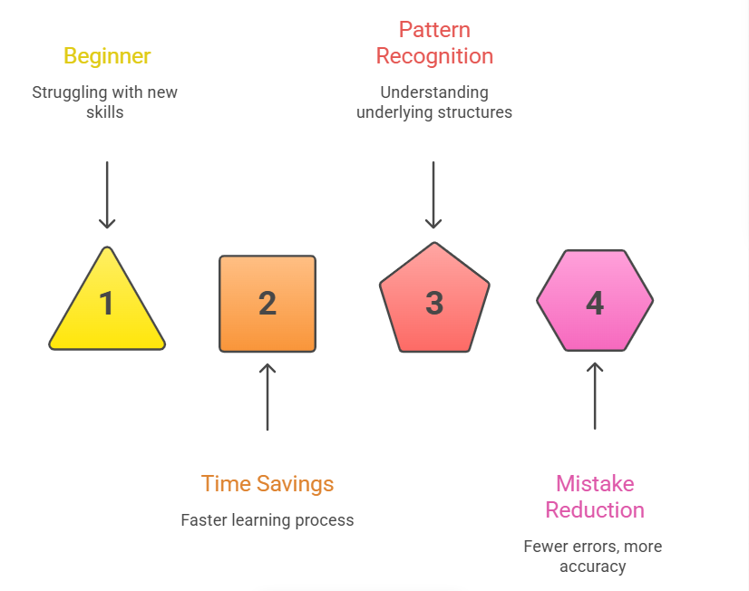
Benefits for Beginners
Notes:
Struggling with a New Skill - When beginners start learning a new tool or programming language, they often struggle with remembering syntax, commands, or the correct approach to solve a problem. AI assistants or smart tools help reduce this struggle by suggesting the next steps, providing examples, and guiding learners while they work. This makes the learning process less intimidating and more interactive.
Time Reduction- Beginners usually spend a lot of time searching for solutions online or debugging small issues. With AI-powered suggestions, tasks can be completed much faster. Instead of starting from scratch, learners receive instant suggestions, templates, or code snippets that help them move forward quickly.
Pattern Recognition- AI tools are trained on large datasets and can recognize common coding or data patterns. This helps beginners understand best practices, common structures, and standard approaches used in real-world scenarios. Over time, learners start recognizing these patterns themselves and improve their problem-solving ability.
Mistake Reduction - Beginners often make small errors such as syntax mistakes, incorrect functions, or logical issues. AI tools can detect these errors early and suggest corrections. This reduces frustration, helps learners debug faster, and improves the overall quality of their work.

Slide 9

Benefits for Beginners
Saves Time
You type: function to check even or odd
Copilot suggests:
def check_even_odd(num): if num % 2 == 0: return "Even" else: return "Odd’’
Helps Learn Python
Copilot shows: Proper indentation, Correct syntax, Function structures, Loop patterns
You can: Accept, Study, Modify, Learn from it.
Reduces Typing Errors
Copilot = Spell-check for code
It helps avoid: Missing colons, Wrong indentation, Incorrect variable names
Notes:
GitHub Copilot is very useful because it saves a lot of time while coding. For example, if you type a comment such as “function to check even or odd”, Copilot can automatically suggest a complete function. It may generate code like a Python function that checks whether a number is even or odd using a simple condition. This helps programmers avoid writing every line from scratch.
Another benefit is that Copilot helps students learn Python while coding. The suggestions show correct indentation, proper syntax, function structure, and common loop patterns. By observing these suggestions, students can understand how good Python code is written. They can choose to accept the suggestion, study it, modify it if needed, and learn from it.
Copilot also reduces typing errors. It works somewhat like a spell-checker for code. It helps prevent common mistakes such as missing colons, incorrect indentation, or wrong variable names. This makes coding smoother and helps beginners focus more on the logic rather than small syntax mistakes.

Slide 10
What Languages Does Copilot Support Best?
Python
JavaScript
Java
C#
Why Python is recommended for Beginners?
Simple syntax
English-like
Used in AI, Data Science, Web
Huge community support
Notes:
GitHub Copilot can suggest code in many programming languages such as Python, JavaScript, Java, and C#.
For beginners, Python is recommended because it has simple and easy-to-read syntax. The code looks similar to plain English, which makes it easier to understand.
Python is also widely used in AI, Data Science, and Web development, and it has a large community, so learners can easily find help and resources.

Slide 11



Tools You Need – Overview
VS Code
Python (3.10+)
GitHub account
GitHub Copilot Extension
Notes:
VS Code (Visual Studio Code). This is a lightweight and powerful code editor widely used by developers. It supports multiple programming languages and provides features such as syntax highlighting, extensions, and an integrated terminal, which make coding easier and more efficient.
Python version 3.10 or above. Python will be the programming language we use for our examples and exercises. It is beginner-friendly, easy to read, and widely used in areas like data science, artificial intelligence, and automation.
GitHub is a platform where developers store and manage their code. It also allows us to integrate tools like Copilot and collaborate with others.
GitHub Copilot is an AI-powered coding assistant that suggests code as we type. It helps developers write code faster, learn new programming patterns, and reduce repetitive work.

Slide 12
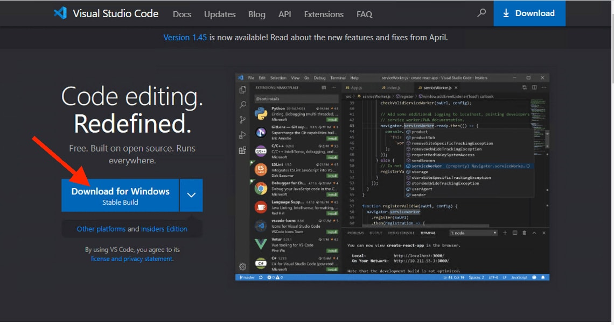
Download & Install VS Code
Why VS Code?
Free
Lightweight
Most popular editor
Works on Windows, Mac, Linux
Installing VS Code – Windows
https://code.visualstudio.com/download
Double-click installer
Next → Next. Select “Add to PATH”. Finish
Notes:
Why VS Code? Visual Studio Code is widely used because it is free, lightweight, and easy to use. It is also one of the most popular code editors used by developers around the world. Another advantage is that it works on Windows, Mac, and Linux, making it accessible to many users.
Installing VS Code on Windows To install it, first go to https://code.visualstudio.com/download and download the Windows version. After downloading, double-click the installer file. Then follow the installation steps by clicking Next → Next, select the option “Add to PATH”, and finally click Finish to complete the installation.

Slide 13
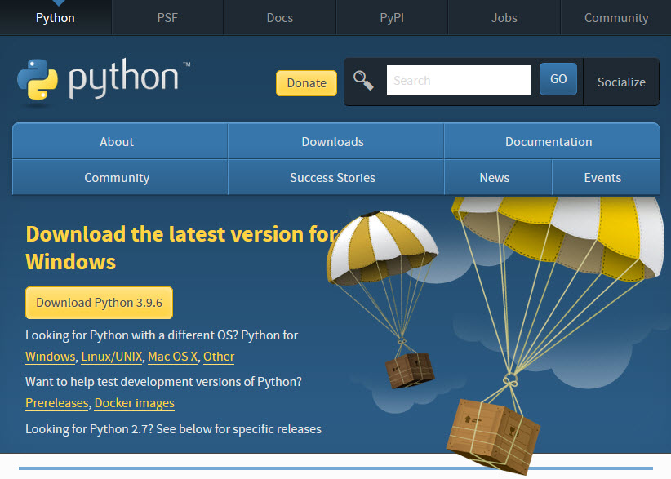
Install Python
Why Python 3.10+?
Stable
Compatible with Copilot
Most libraries support it
Installing VS Code – Windows
https://www.python.org/downloads/
Double-click installer. Next → Next.
Select “Add to PATH”. Finish
Verify Python Installation
Open VS Code terminal: python --version
Expected output: Python 3.11.x
Notes:
Why Python 3.10 or higher? Python 3.10+ is recommended because it is stable, works well with GitHub Copilot, and is supported by most modern Python libraries and tools.
Installing Python on Windows Go to https://www.python.org/downloads/ and download the latest Python version. After downloading, double-click the installer and follow the steps by clicking Next → Next. Make sure to select the option “Add Python to PATH”, and then click Finish to complete the installation.
Verify Python Installation After installation, open the VS Code terminal and type: python --version
If Python is installed correctly, the expected output will be something like: Python 3.11.x.

Slide 14
Common Install Problems
“Python not recognized” → Reinstall with PATH checked
Wrong Python version → Install latest
Terminal not opening → Restart VS Code
Notes:
Sometimes students may face small issues during setup.
If the message “Python not recognized” appears, it usually means Python was installed without adding it to the PATH. In this case, reinstall Python and make sure the “Add to PATH” option is checked.
If the wrong Python version is installed, simply download and install the latest version of Python from the official website.
If the VS Code terminal is not opening or not working properly, restarting VS Code or the computer usually resolves the issue.

Slide 15
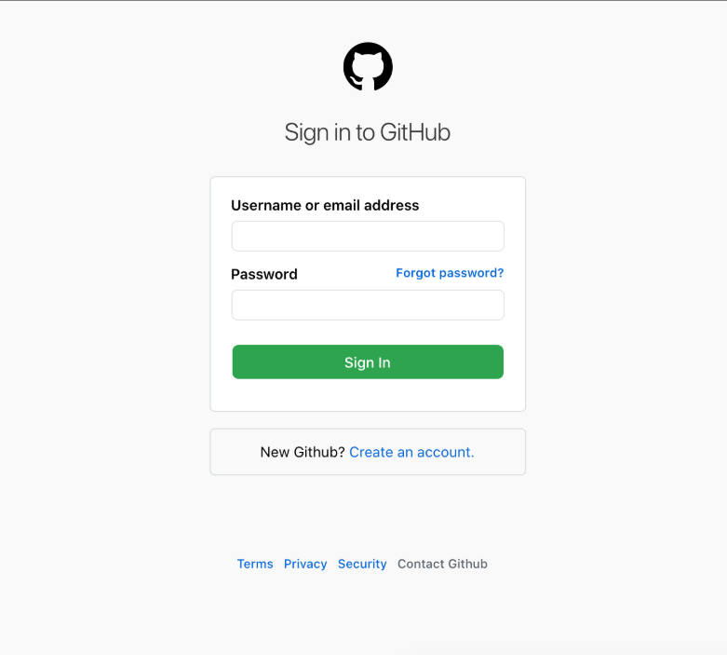
Create GitHub Account
Go to: https://github.com/signup
Create free account.
GitHub Copilot Access (2026 Status)
Options:
Free trial
Student Developer Pack (Free for verified students)
Paid monthly subscription
Notes:
to start using GitHub services, go to https://github.com/signup and create a free GitHub account. This account will allow students to access repositories, extensions, and tools like GitHub Copilot.
For GitHub Copilot access, there are a few options available. Students can start with a free trial. Another option is the Student Developer Pack, which provides free access to Copilot for verified students. Otherwise, users can subscribe through a paid monthly plan to continue using the service.

Slide 16
Install GitHub Copilot Extension
Open Extensions
Search “GitHub Copilot”
Click Install
Also install: Copilot Chat
Sign In to GitHub
Click Sign In
Browser opens
Authorize VS Code
Return to VS Code
Notes:
To install GitHub Copilot in VS Code, first open the Extensions panel. In the search bar, type “GitHub Copilot” and click Install.
It is also recommended to install Copilot Chat, which allows you to interact with Copilot using natural language.
After installation, click Sign In to GitHub. A browser window will open, where you need to log in and authorize VS Code to access your GitHub account.
Once the authorization is complete, return to VS Code, and Copilot will be ready to assist while coding.

Slide 17
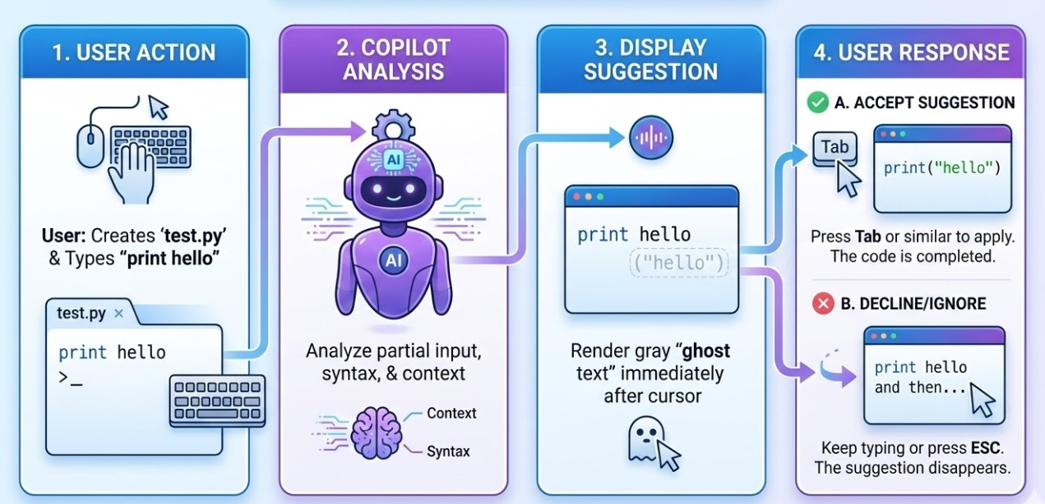
Basic Workflow Diagram
Notes:
This slide explains the basic workflow of how Copilot assists users while working. It shows the simple interaction cycle between the user and the AI assistant.
The process starts with User Action. The user performs an activity such as typing a command, writing a comment, entering data, or asking a question in the application.
Next is Copilot Analysis. Copilot analyzes the user’s input using AI and contextual understanding. It looks at the text, the surrounding content, and the task being performed to understand the user’s intention.
After analyzing the request, Copilot moves to Display Suggestion. Based on the analysis, it generates intelligent suggestions. These suggestions may include code completion, formulas, explanations, summaries, or recommendations depending on the application.
Finally, we have User Response. The user reviews the suggestion and decides whether to accept, modify, or ignore it. If accepted, the suggestion is inserted automatically; if not, the user can continue working or refine the request.

Slide 18
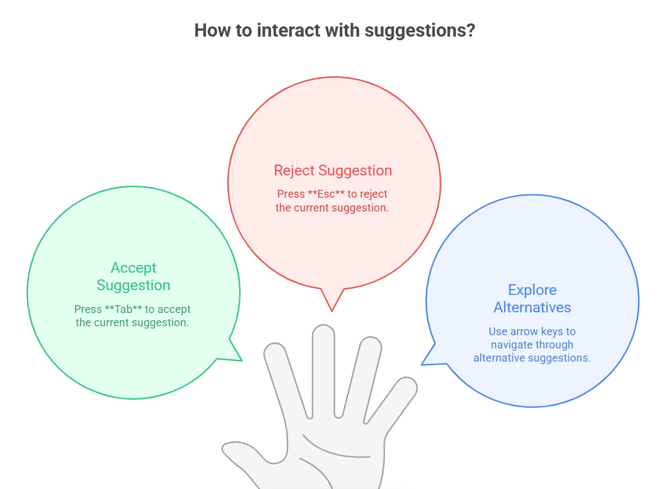
Accepting Suggestions
Notes:
Accept Suggestion - If the suggested code matches what we want, we can quickly accept it by pressing the Tab key. This saves time because the AI completes the entire line or block of code for us. Accepting suggestions helps developers write code faster and reduce manual typing.
Reject Suggestion - Sometimes the suggestion may not be exactly what we need. In that case, we can simply ignore it and continue typing, or press Esc to dismiss the suggestion. This ensures that the developer still has full control over the code.
Explore Alternatives - AI tools often generate multiple possible solutions. We can browse these alternatives using shortcut keys such as Alt + ] or Alt + [ in VS Code. This allows us to compare different coding approaches and choose the best one.

Slide 19
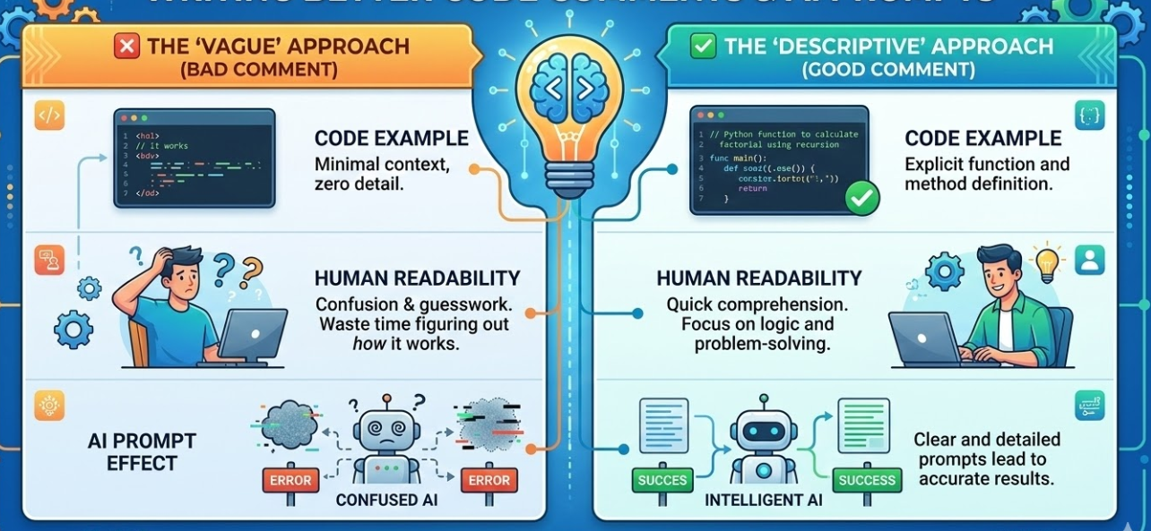
Tips for Better Suggestions
Notes:
Write Clear and Descriptive Comments - Start by writing clear comments explaining what you want the code to do. AI tools like Copilot understand natural language instructions. When your comment is specific, the suggestions become more accurate and useful.
Use Meaningful Variable and Function Names - Good naming helps the AI understand the context of your program. For example, instead of writing x or data, use names like student_marks, total_score, or average_marks.
Break Problems into Small Steps- Instead of asking AI to generate a large block of code, divide the problem into smaller tasks. Write one step at a time. This improves the quality of suggestions and makes the code easier to understand.
Review Suggestions Before Accepting- AI suggestions are helpful, but they are not always perfect. Always read the suggested code carefully before accepting it. Make sure it matches your requirement and follows correct logic.
Keep Writing Code Continuously- AI suggestions improve when you provide more context. The more code you write before requesting suggestions, the better the AI understands what you are trying to build.
Experiment and Learn- Don’t hesitate to modify AI-generated code. Try changing variables, logic, or outputs. This helps you learn programming concepts while using AI as a learning assistant.
Use AI as a Helper, Not a Replacement- Remember that AI tools support your coding process, but understanding the code is still very important. Always try to learn the logic behind the generated code.

Slide 20
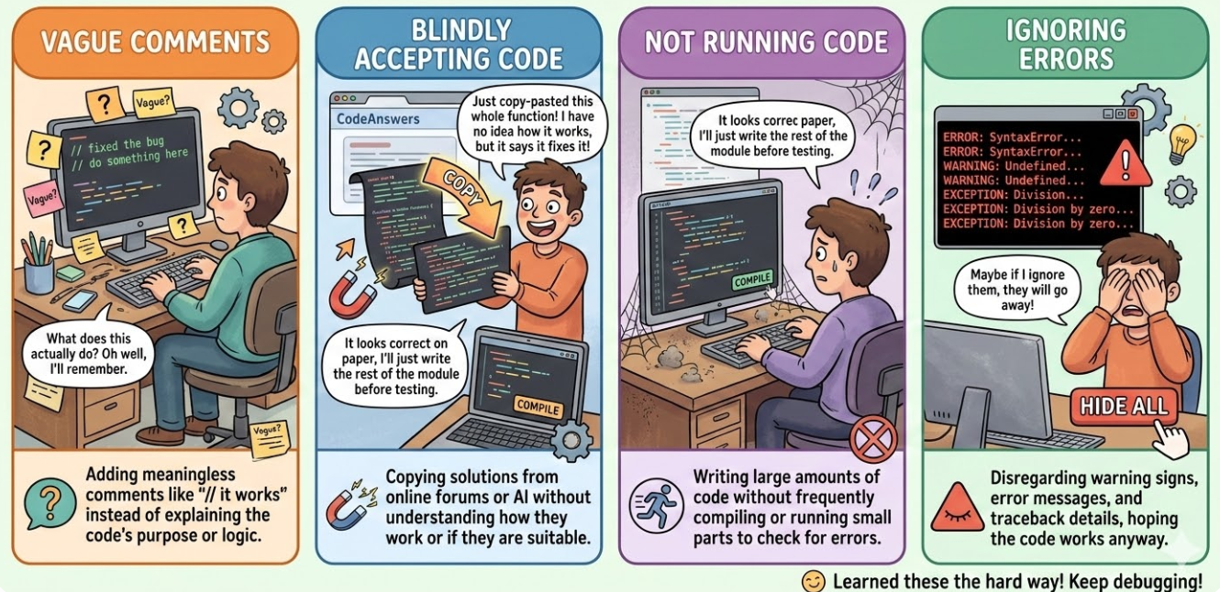
Common Beginner Mistakes
Notes:
Slide: Copilot in Real Life: A Simple Workflow (Speaker Notes Brief)
Summary of Slide
This slide illustrates the core user experience (UX) and developer workflow when interacting with GitHub Copilot, focusing on the four primary stages.
Step 1: Typing a Comment
Key Point: Developer sets context.
The developer writes a clear, concise comment in their language of choice.
Example: // Write a function to check prime.
This instruction acts as the primary "prompt" for Copilot.
Step 2: Copilot Generating
Key Point: AI analyzes and suggests code.
Copilot immediately analyzes the comment, programming language, and project context.
It generates a complete function suggested as "ghost text" (light grey text) in real-time.
The logic is presented before the developer writes a single line of function code.
Step 3: Accepting with Tab
Key Point: Developer reviews and commits.
The developer reviews the suggested code for accuracy, efficiency, and security.
If they approve of the logic, they commit the code to the file with a single "Tab" keystroke.
This commits the AI’s suggestion, instantly integrating it into the project.
Step 4: Complete Function
Key Point: The developer saves time and focuses.
The workflow is complete, and a functional, boiler-plate free function is ready.
Instead of spending minutes writing standard syntax, it took seconds.
The developer can now focus on testing, integration, or other complex tasks the AI cannot solve.
Next Steps & Visual Search
Key Point: Experiencing the workflow live.
The true seamlessness of this "typing-suggestion-acceptance" loop is best understood visually.
For a short, real-time example, search YouTube for: "GitHub Copilot Python demo short".

Slide 21
Module Recap
Today You Learned:
What Copilot is
How it works
Environment setup
Installation steps
First AI-assisted Python program
Notes:
we understood what Copilot is. Copilot is an AI-powered coding assistant that helps developers write code faster by suggesting code snippets, completing lines of code, and even generating entire functions based on comments or prompts.
Next, we discussed how Copilot works. Copilot analyzes the context of the code you are writing and uses machine learning models to generate intelligent suggestions. These suggestions appear automatically while you type, and you can accept them with a simple keystroke like Tab.
We also looked at the development environment setup required to start using Copilot. This included installing tools such as Python, Visual Studio Code, and the Copilot extension, which allows the AI assistant to work directly inside the code editor.
After that, we walked through the installation steps, including signing in to GitHub, enabling the Copilot extension, and confirming that Copilot suggestions are active in the editor.
Finally, you created your first AI-assisted Python program, where Copilot helped generate Python code automatically based on comments and partial commands. This demonstrated how AI can support coding, reduce typing effort, and help beginners learn programming faster.
Overall, today’s session showed how AI can assist programmers in writing, learning, and experimenting with code more efficiently.

Slide 22
Next: Practical Labs
In the next session you will build:
Even/Odd Checker
Simple Calculator
Number Guessing Game
Mini Student Marks Analyzer
Notes:
In the next session, we will move from basic Python syntax to building small interactive programs. These mini projects will help you apply what you have learned about variables, conditions, input/output, and basic logic.
The first program will be an Even/Odd Checker. In this activity, you will write a Python program that takes a number from the user and determines whether the number is even or odd using conditional statements.
Next, you will build a Simple Calculator. This program will allow users to enter numbers and perform basic arithmetic operations such as addition, subtraction, multiplication, and division. This exercise will help you understand user input and decision-making in code.

Slide 23

Lab Activity
Lab 1: Environment Setup Challenge

Slide 24
Lab Activity
Lab 2: First Copilot Suggestion – Simple Print Statements

Slide 25
Lab Activity
Lab 3: Building a Basic Calculator Script

Slide 26
Lab Activity
Lab 4: Reflect & Share – My Copilot Wins

Slide 27

Summary
You will learn in this Chapter:
GitHub Copilot is an AI-powered coding assistant that helps programmers write code faster by suggesting lines of code, functions, and solutions while typing.
To use Copilot effectively, students need to install Visual Studio Code, install Python (version 3.10 or higher), and create a GitHub account.
The GitHub Copilot extension is installed from the VS Code Extensions Marketplace.
Students can write comments or start typing code, and Copilot automatically suggests code snippets or complete functions.
The typical workflow involves thinking about the problem, writing clear comments, typing code, reviewing Copilot suggestions, accepting or editing them, running the program, and improving the solution.
Notes:
GitHub Copilot, an AI-powered coding assistant that helps developers write code faster by suggesting code, functions, and solutions while typing.
To use Copilot, students first need to install Visual Studio Code, install Python version 3.10 or higher, and create a GitHub account.
Next, the GitHub Copilot extension is installed from the VS Code Extensions Marketplace.
Once installed, students can begin coding by writing comments or starting a piece of code. Copilot automatically suggests relevant code snippets or even complete functions.
The typical workflow includes understanding the problem, writing comments, typing code, reviewing Copilot suggestions, accepting or modifying them, running the program, and improving the solution.

Slide 28
Reference
https://docs.github.com/en/copilot
https://code.visualstudio.com/docs/copilot/getting-started
https://code.visualstudio.com/download
https://code.visualstudio.com/docs
https://www.python.org/downloads/
https://github.com/signup
https://techhub.saworks.io/github-copilot-tutorial/
https://www.devscall.com/tutorials/learn-python-with-copilot/setup-your-ai-environment
https://www.geeksforgeeks.org/git/github-copilot/

Slide 29

QUIZ
Let’s Start

Slide 30


Quiz
Q1. What is the main purpose of GitHub Copilot?
To replace programmers
To automatically fix computer hardware
To assist developers by suggesting code while they type
To install programming languages
Answer: C
To assist developers by suggesting code while they type

Slide 31
Quiz
Q2. Which code editor is commonly used with GitHub Copilot?
Notepad
Visual Studio Code
Microsoft Word
Paint
Answer: B
Visual Studio Code

Slide 32
Quiz
Q3. Which key is usually pressed to accept a Copilot suggestion in the editor?
Enter
Shift
Tab
Escape
Answer: C
Tab

Slide 33
Quiz
Q4. Which programming language is commonly used by beginners and works very well with Copilot?
Assembly
C++
Python
COBOL
Answer: C
Python

Slide 34
Quiz
Q5. Which of the following is the correct Copilot workflow?
Run Code → Install Python → Write Program
Think → Write Comment → Start Typing → Accept Suggestion → Run Code
Install Windows → Run Code → Accept Suggestion
Write Program → Delete Code → Run Code
Answer: B
Think → Write Comment → Start Typing → Accept Suggestion→ Run Code

Slide 35
Thank You

